Slide 1
Topic 1：Part II
Abstract data types —
Queue and Linked List
【See Chap17.2 in the textbook】

Slide 2
Abstract data types
a type defined in terms of its behavior rather than its representation

Slide 3
The queue abstraction
Queue：a structure that simulates the behavior of a waiting line.【FIFO-First In First Out】
the following operations of the Queue are important:
Create a new waiting line.
Eliminate an existing waiting line
Add a customer to the end of a waiting line. (enqueue operation)
Remove a customer from the front of a waiting line. (dequeue operation)
Determine how many customers are in a line.

Slide 4

Representing types in the queue abstraction
What data type should we use to represent queue and its elements？
void *： the best is to use the type void *, which matches any pointer type.
abstract type definition：
typedef struct queueCDT *queueADT
SYNTAX for abstract type definitions:
typedef struct nameCDT *nameADT;
Where:
nameADT is the name of the abstract type
nameCDT is the name of the corresponding concrete type
SYNTAX for concrete type definitions:
struct nameCDT {
field-declarations
};
Where:
nameCDT is the name of the concrete type
field-declarations identify the fields in the underlying structure

Slide 5
The queue.h interface(1)
the type queueADT along with five operations on the type: NewQueue, FreeQueue, Enqueue, Dequeue, and QueueLength.
/*
* File: queue.h
* -------------
* This file provides an interface to a simple queue
* abstraction.
*/
#ifndef _queue_h
#define _queue_h
#include "genlib.h"

Slide 6
The queue.h interface(2)
the type queueADT along with five operations on the type: NewQueue, FreeQueue, Enqueue, Dequeue, and QueueLength.
/*
* Type: queueADT
* --------------
* This line defines the abstract queue type as a pointer to
* its concrete counterpart. Clients have no access to the
* underlying representation.
*/
typedef struct queueCDT *queueADT;

Slide 7
The queue.h interface(3)
the type queueADT along with five operations on the type: NewQueue, FreeQueue, Enqueue, Dequeue, and QueueLength.
/*
* Function: NewQueue
* Usage: queue = NewQueue();
* --------------------------
* This function allocates and returns an empty queue.
*/
queueADT NewQueue(void);

Slide 8
The queue.h interface(4)
the type queueADT along with five operations on the type: NewQueue, FreeQueue, Enqueue, Dequeue, and QueueLength.
/*
* Function: FreeQueue
* Usage: FreeQueue(queue);
* ------------------------
* This function frees the storage associated with queue.
*/
void FreeQueue(queueADT queue);

Slide 9
The queue.h interface(5)
the type queueADT along with five operations on the type: NewQueue, FreeQueue, Enqueue, Dequeue, and QueueLength.
/*
* Function: Enqueue
* Usage: Enqueue(queue, obj);
* ---------------------------
* This function adds obj to the end of the queue.
*/
void Enqueue(queueADT queue, void *obj);

Slide 10
The queue.h interface(6)
the type queueADT along with five operations on the type: NewQueue, FreeQueue, Enqueue, Dequeue, and QueueLength.
/*
* Function: Dequeue
* Usage: obj = Dequeue(queue);
* ----------------------------
* This function removes the data value at the head of the queue
* and returns it to the client. Dequeueing an empty queue is
* an error.
*/
void *Dequeue(queueADT queue);

Slide 11
The queue.h interface(7)
the type queueADT along with five operations on the type: NewQueue, FreeQueue, Enqueue, Dequeue, and QueueLength.
/*
* Function: QueueLength
* Usage: n = QueueLength(queue);
* ------------------------------
* This function returns the number of elements in the queue.
*/
int QueueLength(queueADT queue);
#endif

Slide 12

Implementing the queue abstraction
The concrete type definition
struct queueCDT {
void *array[MaxQueueSize];
int len;
};
Notice：MaxQueueSize is a constant specifying the maximum number of elements that can be stored in a queue.
Implement the NewQueue function
queueADT NewQueue (void)
{
queueADT queue;
queue = New(queueADT);
queue->len = 0;
return (queue);
}

Slide 13
Implement the EnQueue function
void Enqueue (queueADT queue, void *obj)
{
if (queue->len == MaxQueueSize) {
Erro (“Enqueue called on a full queue”);
}
queue->array[queue->len++] = obj;
}
Implement the DeQueue function

Slide 14

void *Dequeue (queueADT queue)
{
void *result;
int i;
if (queue->len == 0) Error (“Dequeue of empty queue”);
result = queue->array[0];
for (i = 1; i < queue->len; i++) {
queue->array[i – 1] = queue->array[i];
}
queue->len--;
return (result);
}

Slide 15
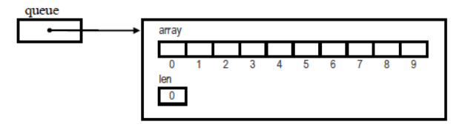
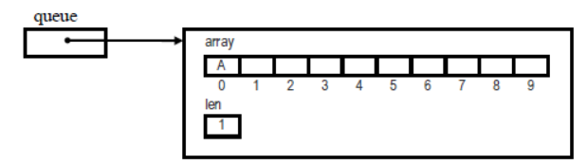

Example
/*created a new queue. The effect of this statement is
to created an empty queue with the following structure
*/
queue = NewQueue ();
Enqueue (queue, “A”);

Slide 16
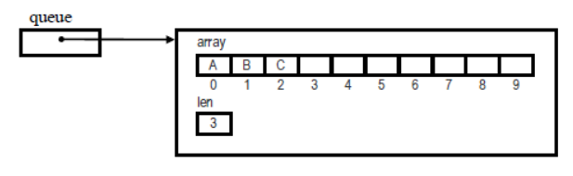
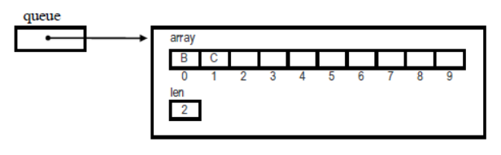
Enqueue (queue, “B”);
Enqueue (queue, “C”);
Dequeue (queue);

Slide 17
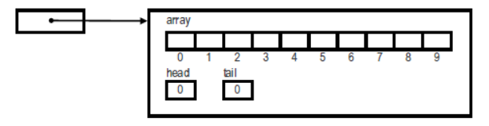
Alternative implementations of the queue abstraction
The method in preceding section has two problems that limit its utility.
Calling is inefficient. (Especially for Dequeue operation)
The queue has a fixed maximum size specified by the constant MaxQueueSize
Solve the efficiency problem of Dequeue.
struct queueCDT {
void *array[MaxQueueSize];
int head;
int tail;
};

Slide 18
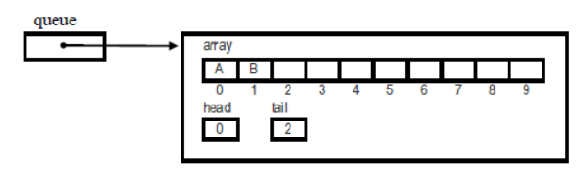
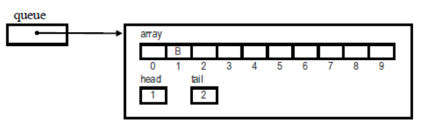
Example
Dequeue (queue)
eliminates the need to shift any data as part of the Dequeue operation.

Slide 19
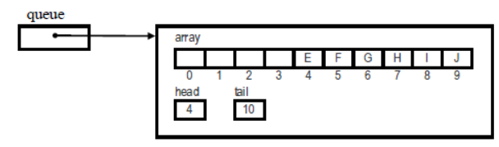
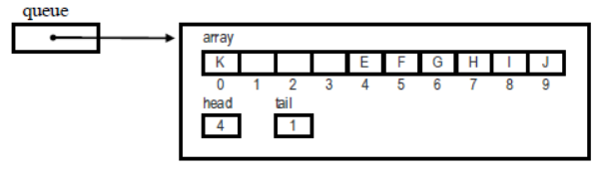

Special Case
What happens when customer K arrives?
There are no vacant positions at the end of the array.
In this design, the end of the array ―wraps around to the beginning, so that the array acts more like a circle than a liner list.
Ring buffer

Slide 20
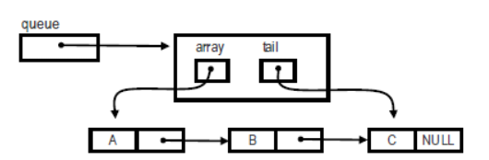

Solve the efficiency problem of fixed maximum size:
Queues are often implemented in an entirely different way——linked list

Slide 21


The stack abstraction
Stack：a structure that LIFO(Last In First Out)
6
5
6
5
4
3
5
2
6
1

Slide 22
The stack abstraction
the following operations of the Stack are important:
Create a new stack.
Check if a stack is empty
Push an element to the top of a stack. (push operation)
Pop an element from the top of a stack. (pop operation)

Slide 23
Representing types in the stack abstraction
abstract type definition：
typedef struct stackCDT *stackADT
SYNTAX for abstract type definitions:
typedef struct nameCDT *nameADT;
Where:
nameADT is the name of the abstract type
nameCDT is the name of the corresponding concrete type
SYNTAX for concrete type definitions:
struct nameCDT {
field-declarations
};
Where:
nameCDT is the name of the concrete type
field-declarations identify the fields in the underlying structure

Slide 24
The stack.h interface(1)
the type stackADT along with five operations on the type: NewStack, FreeStack, PushStack, PopStack, and IsemptyStack.
/*
* File: stack.h
* -------------
* This file provides an interface to a simple stack
* abstraction.
*/
#ifndef _stack_h
#define _stack_h
#include "genlib.h"

Slide 25
The stack.h interface(2)
the type stackADT along with five operations on the type: NewStack, FreeStack, PushStack, PopStack, and IsemptyStack.
/*
* Type: stackADT
* --------------
* This line defines the abstract stack type as a pointer to
* its concrete counterpart. Clients have no access to the
* underlying representation.
*/
typedef struct stackCDT *stackADT;

Slide 26
The queue.h interface(3)
the type stackADT along with five operations on the type: NewStack, FreeStack, PushStack, PopStack, and IsemptyStack.
/*
* Function: NewStack
* Usage: stack = NewStack();
* --------------------------
* This function allocates and returns an empty stack.
*/
stackADT NewStack(void);

Slide 27
The stack.h interface(4)
the type stackADT along with five operations on the type: NewStack, FreeStack, PushStack, PopStack, and IsemptyStack.
/*
* Function: FreeStack
* Usage: FreeStack(stack);
* ------------------------
* This function frees the storage associated with stack.
*/
void FreeStack(stackADT stack);

Slide 28
The stack.h interface(5)
the type stackADT along with five operations on the type: NewStack, FreeStack, PushStack, PopStack, and IsemptyStack.
/*
* Function: PushStack
* Usage: PushStack(stack, obj);
* ---------------------------
* This function adds obj to the top of the stack.
*/
void PushStack(stackADT stack, void *obj);

Slide 29
The stack.h interface(6)
the type stackADT along with five operations on the type: NewStack, FreeStack, PushStack, PopStack, and IsemptyStack.
/*
* Function: PopStack
* Usage: obj = PopStack(stack);
* ----------------------------
* This function removes the data value at the top of the stack
* and returns it to the client. PopStacking an empty stack is
* an error.
*/
void *PopStack(stackADT stack);

Slide 30
The stack.h interface(7)
the type stackADT along with five operations on the type: NewStack, FreeStack, PushStack, PopStack, and IsemptyStack.
/*
* Function: IsemptyStack
* Usage: IsemptyStack(stack);
* ------------------------------
* This function checks if the stack is empty.
*/
bool IsemptyStack(stackADT stack);
#endif

Slide 31
Implementing the stack abstraction
The concrete type definition
struct stackCDT {
void *array[MaxStackSize];
int top;
};
Notice：MaxStackSize is a constant specifying the maximum number of elements that can be stored in a stack.
Implement the stack function
……

Slide 32
Applications of the stack
The function calling in a C program.
Calculating the value of a expression in postfix notation
(后缀表示), or Reverse Polish Notation(逆波兰式表示)
5 * ( ( 9 + 8 ) * ( 4 * 6 ) + 7 ) infix notation
➔ 5 9 8 + 4 6 * * 7 + * Reverse Polish Notation
……

Slide 33
Linked List(链表)
Linked list: a linked list is a dynamic data structure consisting of a group of nodes which together represent a sequence. Usually, linked list can be classified as single linked list and doubly linked list.
head pointer
head node
tail node
node

Slide 34
Array vs Linked List
Array:
fixed length;
waste space if the number of elements in array is uncertain.
Linked list:
a dynamic storage data structure.
dynamically allocate space; freely and easily insert a new element (node)
save memory and improve operational efficiency.

Slide 35
Linked List
Problem description:
Create a single linked list recording students’ score (including student ID, name, score), in ascending order of student ID. It is required to achieve the insertion, modify, delete, and traversal operations.
main
Create_Stu_Doc
InsertDoc
DeleteDoc
Print_Stu_Doc
InsertDoc

Slide 36
Pseudocode
struct stud_node{ /* Linked list node type */
int num;
char name[20];
int score;
struct stud_node *next;
};
struct stud_node * Create_Stu_Doc(); /* create a new list*/
struct stud_node * InsertDoc(struct stud_node * head, struct stud_node *stud); /* insert into the list */
struct stud_node * DeleteDoc(struct stud_node * head, int num); /* delete from the list*/
void Print_Stu_Doc(struct stud_node * head); /* traverse*/

Slide 37
Concept of Linked List
Definition of a single linked list node
struct stud_node {
int num;
char name[20];
int score;
struct stud_node *next;
};
recursive definition of the structure

Slide 38
Concept of Linked List
Dynamic allocation functions
void *malloc(unsigned size)
Description: Allocates a block of size bytes of memory
Return: Returns a pointer to the memory block allocated by the function. If allocation fails, a NULL pointer is returned.
Example：(int *) malloc (sizeof(int))
(struct student *) malloc(sizeof(struct student))
void free(void *ptr)
Description: free a block of memory previously allocated by calling malloc(), making it available again for further allocations. ptr is a pointer to the previously allocated memory
Return: no returns
Example：free(p)

Slide 39

Create a single linked list
Head = tail = NULL
Input:num,name,score
False
Num != 0
True
Malloc memory unit
P =(struct stud_node*)malloc(size)
Insert: num,name,score
P->next = NULL
Head == NULL
False
True
Tail-> next = p
Head = p
Tail = p
End
Output:num,name,score

Slide 40
head = tail = NULL;
scanf("%d%s%d", &num, name, &score);
while(num != 0){
p = (struct stud_node *) malloc(size);
p->num = num;
strcpy(p->name, name);
p->score = score;
p->next = NULL;
if(head == NULL)
head = p;
else
tail->next = p;
tail = p;
scanf("%d%s%d", &num, name, &score);
}
Head insertion：
p->next=head;
head=p;

Slide 41
Operations of a single linked list
Traverse the list
Insert node
Delete node

Slide 42
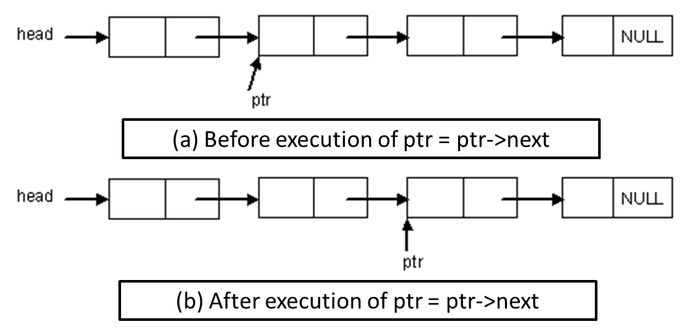
Operations of a single linked list
Traverse the list
for(ptr = head; ptr!=NULL; ptr = ptr->next)
printf("%8d %20s %6d \n", ptr->num, ptr->name, ptr->score);

Slide 43
Operations of a single linked list
Insert node
head
ptr
s
Connect : s->next = ptr->next
Break : ptr->next = s

Slide 44
Operations of a single linked list
Delete node
head
ptr1
ptr2
head
ptr1
ptr2
ptr2=ptr1->next
connect:ptr1->next=ptr2->next
ptr1->next=
ptr1->next->next
delete: free(ptr2)

Slide 45
Home Work(2题)
1、P645：Programming Exercise 7 in the textbook.
2、已知两个非降序链表序列S1与S2，设计函数构造出S1与S2的并集新非降序链表S3。要求：
（1）输入说明：输入分2行，分别在每行给出由若干个正整数构成的非降序序列，用-1表示序列的结尾（-1不属于这个序列）。数字用空格间隔。
（2）输出说明：在一行中输出合并后新的非降序链表，数字间用空格分开，结尾不能有多余空格；若新链表为空，输出“NULL”。
（3）例如：
输入：
1 3 5 -1
2 4 6 8 10 -1
输出：
1 2 3 4 5 6 8 10

Slide 46
Project 下面题目中选做一题：
1、请利用堆栈实现简单计算器功能，要求能对带有+-*/和()的算术表达式求值。可选做的提高要求：运算数中可以有sin、cos、pow等简单函数，如（3+sin(2))*4+5
2、可利用链表表示一个多项式，如3x⁵-2x+1可用 （3，5）、（-2，1）、（1，0）序列的链表表示。请设计能进行两个多项式加、减、乘运算的函数，并设计相应程序能根据要求进行多项式输入、运算和输出。
注：Project除要求编写程序（含注释）外，还需要有相应技术报告文档。

